Slide 1
RPG Text Base Game
D5 Something

Slide 2
The Game:
Story – unknown so far
Genre – fantasy
Type of game – RPG
Multiple choice/open world (text based)

Slide 3
The Design… So far…
Fantasy game which the story has not yet been completely decided just yet but the player would have the option as the game progresses to pick a certain type of class that they would want to keep for the rest of the game, undecided if there will be a way for them to be able to change this later on in the game.
Game would be set in the past currently so currency would be called Tamriel.
there can also be some type of strange language that would be only known depending on how the character would have started or things they would have gone through the game. This can be a race or translation spell they wanted to do.

Slide 4
Temp story:
Character lives a normal life when something tragic happens to their village. They are then given the choice to do something about the situation or back down and let their village still scum to abuse and mistreatment.
THIS IS UNFINISHED. DAMN You SIMON!!!!

Slide 5
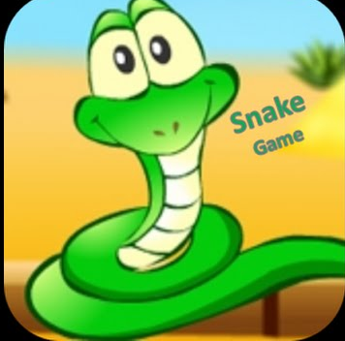
Pitch 2: Simple Snake

Slide 6
The Game:
Story – Inline with the original snake game but chasing letters instead
Genre – Arcade
Type of game – Strategy Game
Open World (Text based)

Slide 7
The Design… So far…
Similar to the original snake game but the snake replaced with letters (as opposed to a snake in the original version). The main aim of the game is for the user to control the snake and chase the letters, which will be the food.
User score – Every time the user collects a letter it is added to the score. The score is then presented at the end of the game and stored on the leader board.
Lives – The user will be given 3 chances (lives).

